Slide 1
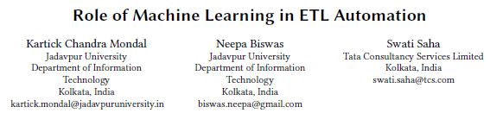
2021. 01. 13
Presented by
Md. Tanvir Ahemd
IT Convergence and Application Engineering
Pukyong National University, Korea

Slide 2
Contains
Abstract
Introduction
Related Work
Case Study
Proposed Solution
Conclusion and Future Work

Slide 3
Abstract
Data Warehouse
What is Data Warehouse?
What is Extract Transformation Load (ETL)?
Difference between Data warehouse and ETL
Notes:
https://www.guru99.com/etl-extract-load-process.html#:~:text=ETL%20is%20a%20process%20that,is%20Extract%2C%20Transform%20and%20Load.

Slide 4
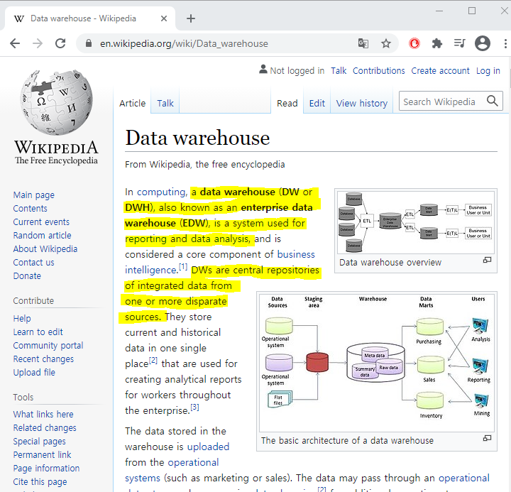
Abstract
What is Data Warehouse?
Notes:
Data Warehouse = https://www.youtube.com/watch?v=AHR_7jFCMeY

Slide 5
Abstract
What is Data Warehouse?
Structuring all the best quality data in one place.
Notes:
Data Warehouse = https://www.youtube.com/watch?v=AHR_7jFCMeY

Slide 6
Abstract
Data Warehouse Example
Staff
PKNU Departments
IT CAE
Computer Engineering (CE)
Electronic Engineering (EE)
Civil Engineering (CE)
Architecture
Safety Engineering (SE)
Display Engineering (DE)
Materials Engineering (ME)
English Department
Business Department
2
3
1
4
Staff
Students
PKNU President
10
5
YG
BSc
Staff
Yearly Graduates
Students
BSc/MSc/PhD
6
9
7
8

Slide 7








Abstract
Data Warehouse Example
IT CAE
(CE)
(EE)
Ci (CE)
Architecture
(SE)
(DE)
(ME)
English Department
Business Department
Staff
Staff
PKNU President
Staff Info.
Staff
Staff
Notes:
Data Warehouse = https://www.youtube.com/watch?v=AHR_7jFCMeY

Slide 8
Abstract
Data Warehouse Example
Safety Engineering (SE)
PKNU Departments
IT CAE
Computer Engineering (CE)
Electronic Engineering (EE)
Civil Engineering (CE)
Architecture
Safety Engineering (SE)
Display Engineering (DE)
Materials Engineering (ME)
English Department
Business Department
Staff
&
Students
2
3
1
4
Staff
Students
Staff
Students
PKNU President
10
5
YG
BSc
Staff
Staff
Yearly Graduates
Students
BSc/MSc/PhD
Staff
Students
Students
6
9
7
8

Slide 9
Abstract
Data Warehouse Example
SE: Staff
SE: Staff
PKNU President
SE: Staff
SE: Staff
Notes:
Data Warehouse = https://www.youtube.com/watch?v=AHR_7jFCMeY

Slide 10

Abstract
Data Warehouse Example
Staff
Students
PKNU President
Data Warehouse
MSc
BSc/PhD
Notes:
Data Warehouse
https://www.youtube.com/watch?v=AHR_7jFCMeY

Slide 11
Abstract
Data Warehouse Example
Staff
ETL
ETL
Students
PKNU President
ETL
Data Warehouse
MSc
ETL
BSc/PhD
Notes:
Data Warehouse
https://www.youtube.com/watch?v=AHR_7jFCMeY

Slide 12


Abstract
Data Warehouse Example
One single place One single source of information.
So Data warehouse is means, where valuable data assets are stored.
Stuff/Students
Faculty
Employees
Notes:
Data Warehouse = https://www.youtube.com/watch?v=AHR_7jFCMeY

Slide 13
Abstract
Defining Features of a Data Warehouse
Subject Oriented
Integrated
Time variant
Non Volatile
Summarized

Slide 14
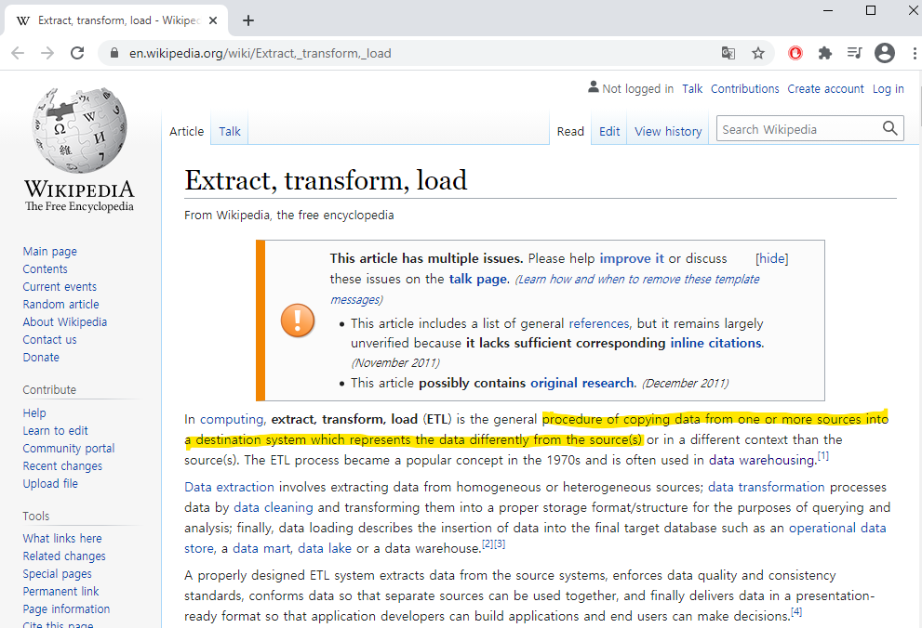
Abstract
What is Extract Transformation Load (ETL)?

Slide 15


Abstract
What is Extract Transformation Load (ETL)?
ETL
ETL
Staging Area
Data Warehouse
DB
Transformation
Loading
Actually data is read from the different types of sources from the source system and loaded into staging table and then finally after the transformations complete it is wrote into a data warehouse, so the complete process of extracting the data transforming the data and loading the data into warehouse is called extract transform and load or ETL.
Extraction

Slide 16
Abstract
What is Extract Transformation Load (ETL)?
ETL
ETL
Staging Area
Data Warehouse
DB
Extraction
Transformation
Loading

Slide 17
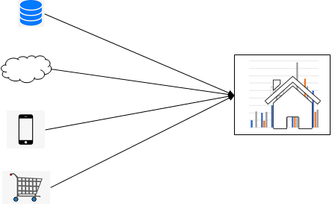
Abstract
What is Extract Transformation Load (ETL)?
ETL
ETL
Staging Area
Data Warehouse
DB
Extraction
-- Partial Extraction
With update notification.
-- Partial Extraction
Without update notification.
Notes:
Help sources
https://www.youtube.com/watch?v=WZw0OTgCBOY

Slide 18
Abstract
What is Extract Transformation Load (ETL)?
ETL
ETL
Staging Area
Data Warehouse
DB
Transformation
Data Extracted into a staging server is a raw data and can not be used as it is. It needs to be Cleansed, Mapped and Transformed.
Notes:
Basic transformation Tasks
-- Selection
The selection waring we select the data which is required to be loaded into it they are get up here house.
-- Matching

Slide 19
Abstract
What is Extract Transformation Load (ETL)?
ETL
ETL
Staging Area
Data Warehouse
DB
Loading
Data loading fetches the prepared data, applies it to the warehouse and stores it in the database.
Notes:
Help sources
https://www.youtube.com/watch?v=WZw0OTgCBOY

Slide 20
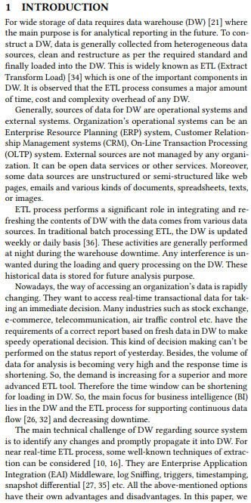
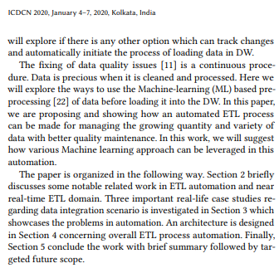
Introduction
Role of Machine Learning in ETL Automation
The main purpose is for analytical reporting in the future.
The main purpose will explore if there is any other option which can track changes and automatically initiate the process of loading data in DW.

Slide 21
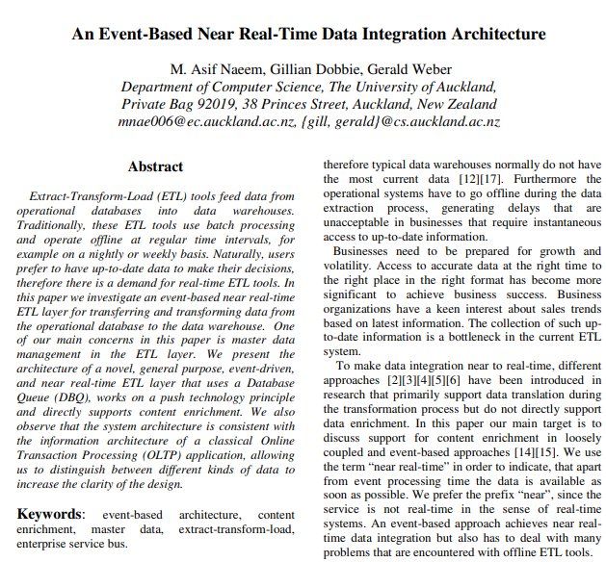
Related Work
An Event-Based Near Real-Time Data Integration Architecture

Slide 22
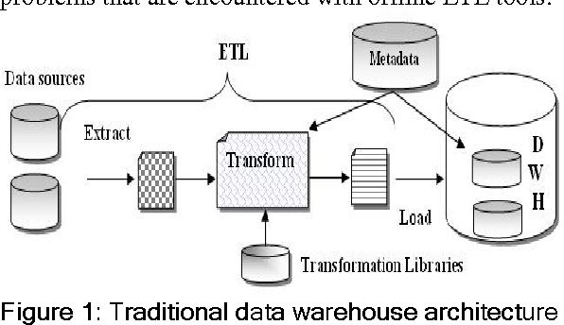
Related Work
An Event-Based Near Real-Time Data Integration Architecture
Master data
- Master data is not extracted in each transaction.
Transactional data
- Transaction data is followed by the required enrichment process and master data is directed to the master data repository.

Slide 23
Case Study
Existing Method
Case Study
Retail Domain
Marketing Domain
Financial Services Domain
Notes:
Describe different company structure.

Slide 24
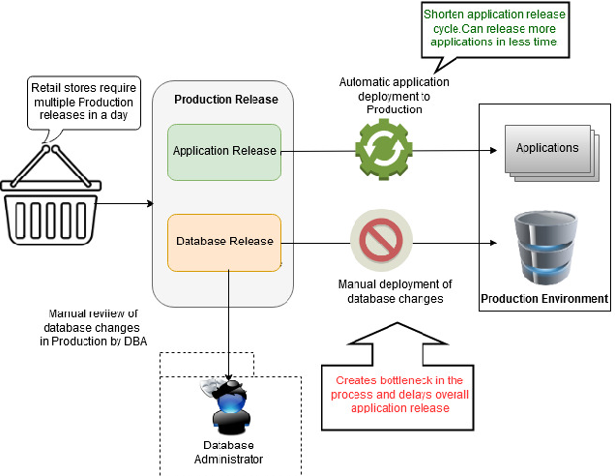
Case Study
1. Retail Domain Screen layout

Slide 25
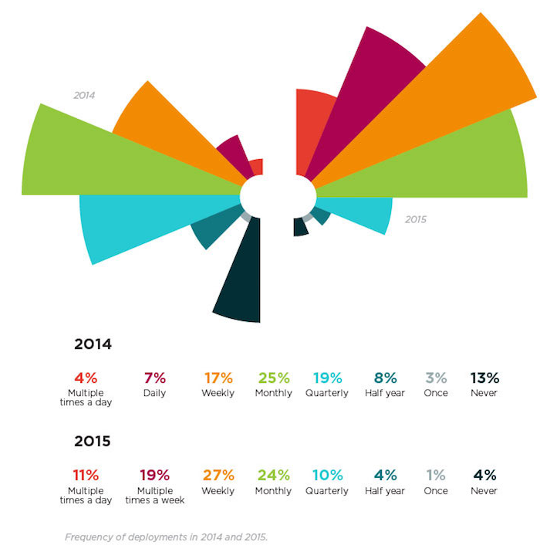
Case Study
1. Retail Domain
Amazon deploys code in every 11.7 sec in a day for production.
Netflix deploys code at least thousand times per day.
Amazon deploys

Slide 26
Case Study
2. Marketing Domain
Philippine based retail affiliated marketing company.
-- The company wants to do finer target marketing by emails, gain and loss data.
Now the challenge is how to automate these processes to ensure that all processes executed successfully.

Slide 27
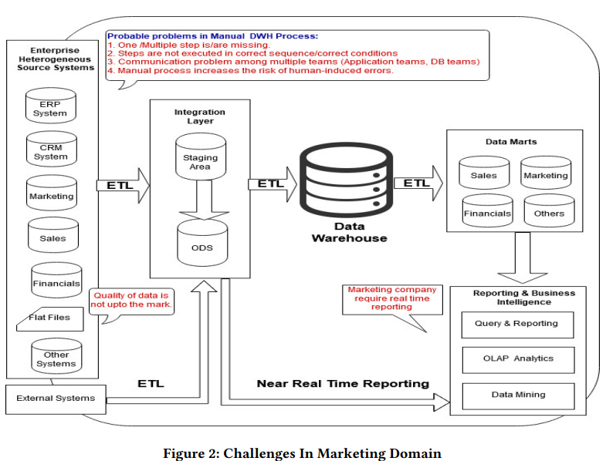
Case Study
2. Marketing Domain

Slide 28
Case Study
2. Marketing Domain
Missing data or non-accurate data are also causing serious implications in many cases.
There are some scenarios where bad quality data disturbs in making important decisions.

Slide 29
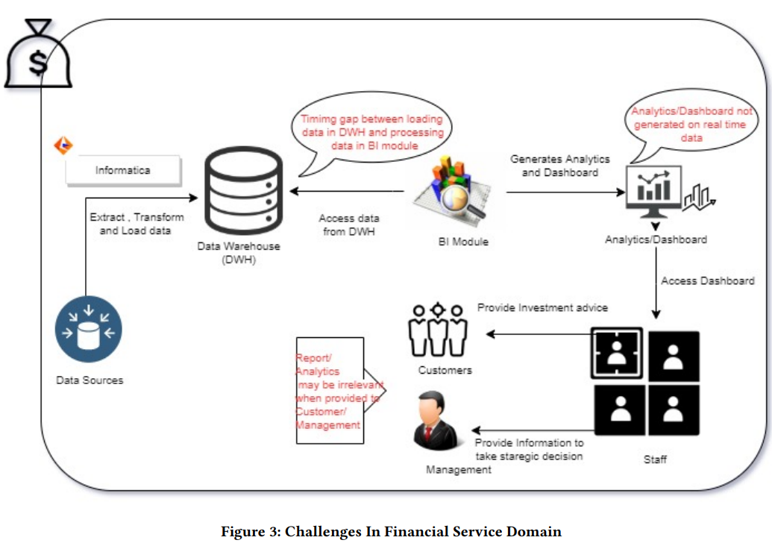
Case Study
3. Financial Services Domain

Slide 30
Proposed Solution
Proposed Solution Types
Automated Data Integration.
Details of Major Components

Slide 31
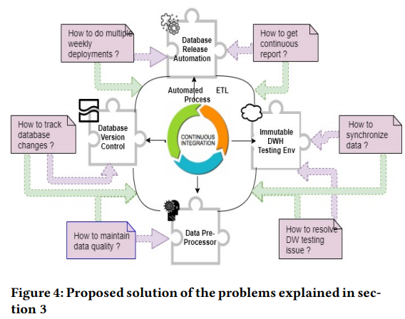
Proposed Solution
Automated Data Integration

Slide 32
Proposed Solution
Automated Data Integration
Existing Method
Proposed Method
The company can support easily multiple weekly deployments by using Database Release Automation component.
It is reducing the processing time significantly and produce a good quality of data from the data warehouse.

Slide 33
Proposed Solution
Automated Data Integration
Existing Method
Proposed Method
The company can support easily multiple weekly deployments by using Database Release Automation component.
It is reducing the processing time significantly and produce a good quality of data from the data warehouse.

Slide 34
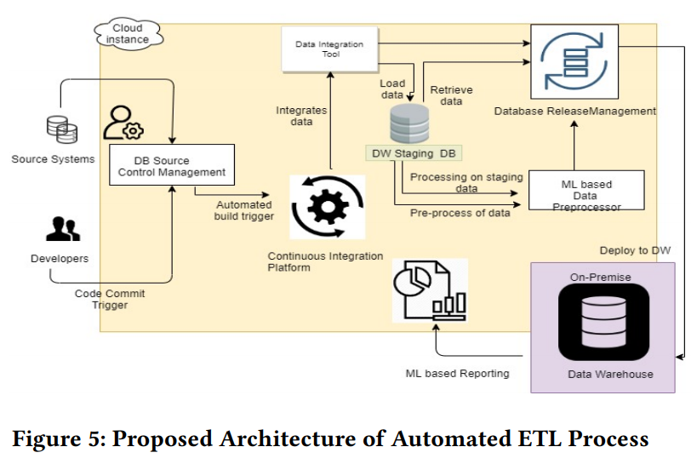
Proposed Solution
Details of Major Components

Slide 35
Proposed Solution
Details of Major Components
https://jenkins.io/

Slide 36

Proposed Solution
Details of Major Components
https://jenkins.io/

Slide 37
Conclusion and Future Study
Conclusion and Future Study
We have concentrated on automating ETL process. So that with minimum or no manual intervention, data can be loaded in DW.
The proposed approach supports automating data processing including database release automation.
Proof-of-concept has been performed on Liquibase tool which is used as database source control for managing database changes.
The study will be continued on machine learning approaches and identification of other areas of the automated process.

Slide 38
Q & A

